Slide 1
Chapter 9: Virtual Memory

Slide 2
Chapter Objectives
Define virtual memory(虚拟内存) and describe its benefits.
Illustrate how pages are loaded into memory using demand paging(按需调页).
Apply the FIFO, optimal, and LRU page-replacement algorithms(页置换算法), etc.
Describe thrashing(系统颠簸)
Describe the working set(工作集) of a process, and explain how it is related to program locality(局部性).
Describe how Windows and Solaris manage virtual memory.

Slide 3
Content Overview
Background
Demand Paging(按需调页)
Copy-on-Write(写时复制)
Page Replacement(页面置换)
Allocation of Frames(帧分配)
Thrashing(系统颠簸)
Memory-Mapped Files(内存映射文件)
Allocating Kernel Memory(内核内存的分配)
Other Considerations(其他考虑)
Operating-System Examples

Slide 4
9.1 Background(背景)
Code needs to be in memory to execute, but entire program rarely used
Error code, unusual routines, large data structures
Entire program code not needed at same time
Consider ability to execute partially-loaded program
Program no longer constrained by limits of physical memory
Each program takes less memory while running -> more programs run at the same time
Increased CPU utilization and throughput with no increase in response time or turnaround time
Less I/O needed to load or swap programs into memory -> each user program runs faster

Slide 5
Background
第8章的几种存储器管理方法，要求作业在运行前，将作业一次性全部装入内存，直到作业运行完后才能释放内存
作业在每次运行时并非用到其全部程序或数据
条件处理模块
处理异常错误模块
通常声明的内存比实际使用的内存大(e.g. 缓冲区，数组)
有的模块有时因I/O长期等待，但仍需要占用内存

Slide 6
Background
有的程序段很少运行，有的运行一次后便不再需要
有时用户编写的程序长度大于实际安装的物理内存
一般情况下，多道程序需要的内存总量大于实际的物理内存
浪费内存空间，降低了内存的利用率，降低了系统的并发度，减少了系统的吞吐量(指第8章方法)
增加了I/O的时间(装入不需要的模块) (指第8章方法)

Slide 7
Background
Facts：
程序绝大部分时间是顺序执行的(即便是循环，循环体内部大部分指令仍为顺序执行的)
过程调用改变程序的执行轨迹。研究表明，大多数情况下，过程调用的深度不超过5；因此程序会在一段时间内局限在这些过程的范围内运行
程序存在很多循环结构，虽然由少数指令构成，但多次执行；
程序还包括对许多数据结构的处理，例如数组，也都局限于一个很小的范围内

Slide 8
Locality(局部性)
局部性原理（Local Principle, Principle of Locality）
时间局部性
如果程序的某条指令一旦执行，则不久后该指令可能再次执行（e.g. 循环结构）
如果某个数据结构被访问，则不久以后该数据结构可能再次被访问；(e.g. 数组 + 循环结构)
空间局部性
一旦程序访问了某个存储单元，不久之后，其附近的存储单元也被访问（顺序性）（数组、循环）

Slide 9
虚拟存储器的基本思想
虚拟存储器指的是仅把作业的一部分装入内存便可运行作业，具有请求调入功能和置换功能，能从逻辑上对内存容量加以扩充的一种存储器系统
其逻辑容量由内存容量和外存容量之和所决定，其运行速度接近于内存速度，而每位的成本却又接近于外存
基于局部性原理，一个作业在运行之前，没有必要全部装入主存，而仅将那些当前要运行的那部分页面或段，先装入内存即可启动运行，其余部分暂时留在磁盘上
如果程序所需要访问的页(段)尚未调入内存(称为缺页或缺段)，程序应利用OS所提供的请求调页(段)功能，将它们调入内存，以便进程能继续执行下去
如果此时内存已满，无法再装入新的页(段)，则还须再利用页(段)的置换功能，将内存中暂时不用的页(段)调出至磁盘上，腾出足够的内存空间后，再将所要访问的(段)调入内存，使程序继续执行

Slide 10
虚拟存储器的基本思想
虚拟存储器
可使一个大的用户程序在较小的内存空间中运行
可使内存中同时装入更多的进程并发执行
用户在一个虚拟地址空间中编程，无需担心物理内存大小
从用户的角度看，该系统所具有的内存容量，将比实际内存容量大得多，即虚拟存储器
虚拟存储技术是一种性能非常优越的存储器管理技术，故被广泛地应用于大、 中、 小型机器和微型机中

Slide 11
Virtual Memory(虚拟内存)
Virtual memory – separation of user logical memory from physical memory
Only part of the program needs to be in memory for execution
Logical address space can therefore be much larger than physical address space
Allows address spaces to be shared by several processes
Allows for more efficient process creation
More programs running concurrently
Less I/O needed to load or swap processes

Slide 12
Virtual Memory (Cont.)
Virtual address space – logical view of how process is stored in memory
Usually start at address 0, contiguous addresses until end of space
Meanwhile, physical memory organized in page frames
MMU must map logical to physical
Virtual memory can be implemented via:
Demand paging(按需调页)
Demand segmentation(按需调段)

Slide 13
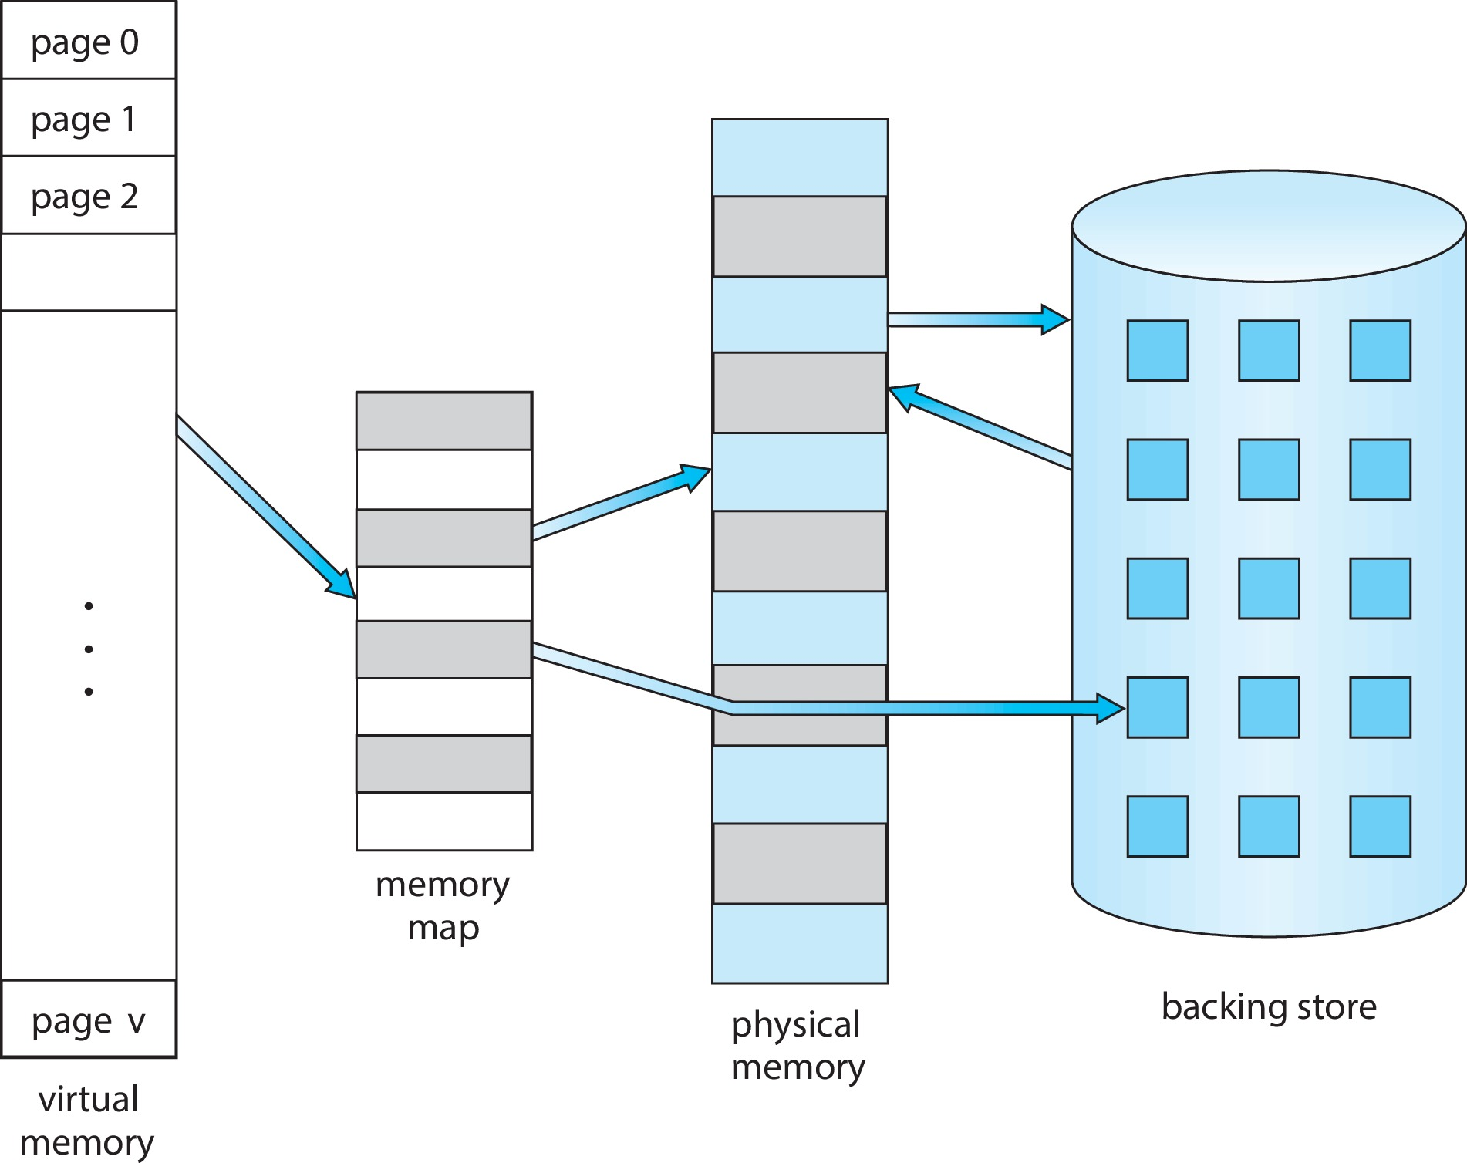
Virtual Memory That is Larger Than Physical Memory

Slide 14
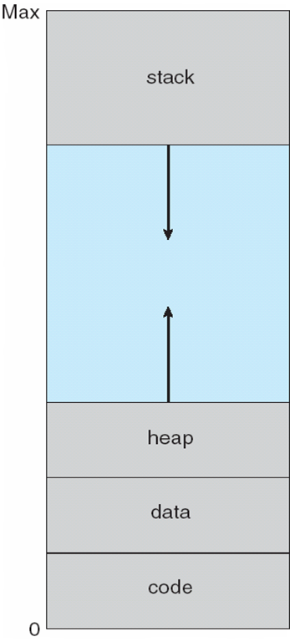
Virtual-Address Space(虚拟地址空间)
Usually design logical address space for stack to start at Max logical address and grow “down” while heap grows “up”
Maximizes address space use
Unused address space between the two is hole
No physical memory needed until heap or stack grows to a given new page
Enables sparse address spaces with holes left for growth, dynamically linked libraries, etc.
System libraries shared via mapping into virtual address space
Shared memory by mapping pages read-write into virtual address space
Pages can be shared during fork(), speeding process creation

Slide 15
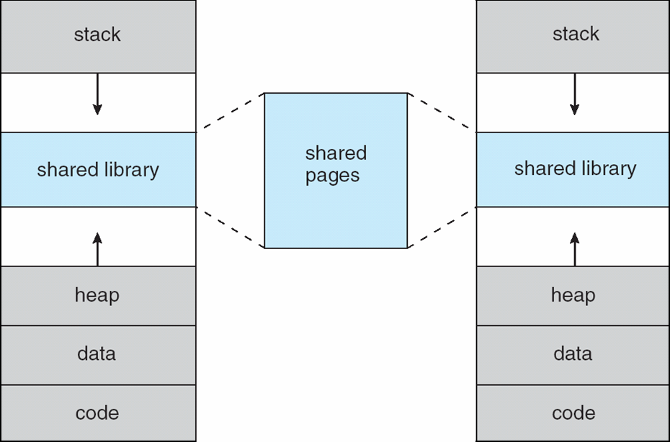
Shared Library Using Virtual Memory

Slide 16
虚拟存储器需要解决的几个问题
一般有请求页式、请求段式、段页式虚拟存储器管理三种
相关的几个问题，或需要解决的问题（以请求页式为例）
当访问到一个页面时，需要检测一个页是否已经在内存；
(page table+ Valid & invalid bit ) or (page table+ existence bit)
当访问页面不在内存，如何处理？
（page fault trap，缺页中断，页面错误，页失效）
当要装入页面时，若内存无空闲页框，如何处理？
（page replacement，页面置换）
当页面置换过于频繁时，会引起系统不稳定，如何处理？
（thrashing，抖动、颠簸、颤抖、颤动）

Slide 17
Page Fault
不同的翻译：页故障(2018年公布的计算机科学技术名词)，页错误，页异常
Hard Page Fault
也被称为Major Page Fault，翻译为硬缺页错误/主要缺页错误，这时物理内存中没有对应的页帧，需要CPU打开磁盘设备读取到物理内存中，再让MMU建立VA和PA的映射
Soft Page Fault
也被称为Minor Page Fault，翻译为软缺页错误/次要缺页错误，这时物理内存中是存在对应页帧的，只不过可能是其他进程调入的，发出缺页异常的进程不知道而已，此时MMU只需要建立映射即可，无需从磁盘读取写入内存，一般出现在多进程共享内存区域
Invalid Page Fault
翻译为无效缺页错误(这是程序真正出错了，或者硬件出错了)，比如进程访问的内存地址越界访问，又比如对空指针引用，内核就会报segment fault错误中断，进程被终止

Slide 18
9.2 Demand Paging(按需调页)
Could bring entire process into memory at load time
Or bring a page into memory only when it is needed
Less I/O needed, no unnecessary I/O
Less memory needed
Faster response
More users
Similar to paging system with swapping (diagram on next page)

Slide 19
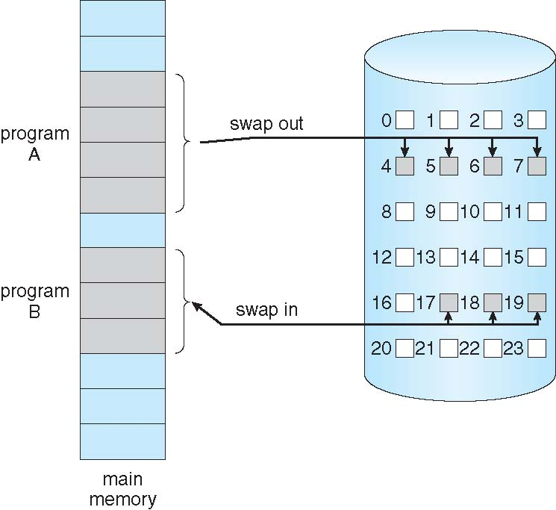
Demand Paging

Slide 20
Basic Concepts
With swapping(在有进程级的换入换出时), pager(调页程序) guesses which pages will be used before swapping out again(指猜测整个进程被再次换出之前，可能使用哪些页)
Instead, pager brings in only those pages into memory
How to determine that set of pages?
Need new MMU functionality to implement demand paging(需要MMU增加按需调页相关的一些功能)

Slide 21
Basic Concepts
If pages needed are already memory resident(已在内存)
No difference from non demand-paging
If page needed and not memory resident(所需页面不在内存)
Need to detect and load the page into memory from storage
Without changing program behavior
Without programmer needing to change code
也就是按需调页对程序及程序员完全透明

Slide 22
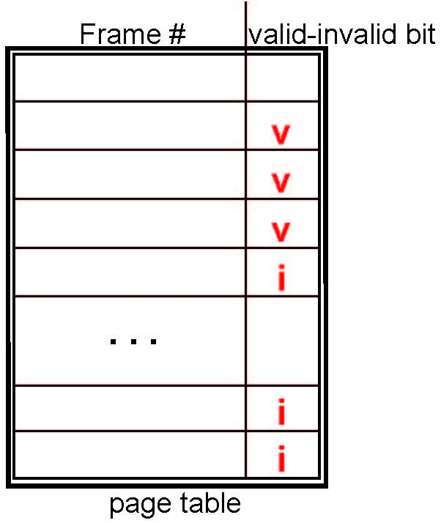
Valid-Invalid Bit(有效-无效位)
With each page table entry a valid–invalid bit is associated (v ⇒ in-memory – memory resident, i ⇒ not-in-memory)
Initially valid–invalid bit is set to i on all entries
Example of a page table snapshot:
During MMU address translation, if valid–invalid bit in page table entry is i ⇒ page fault(页故障)
0
1
2
…

Slide 23
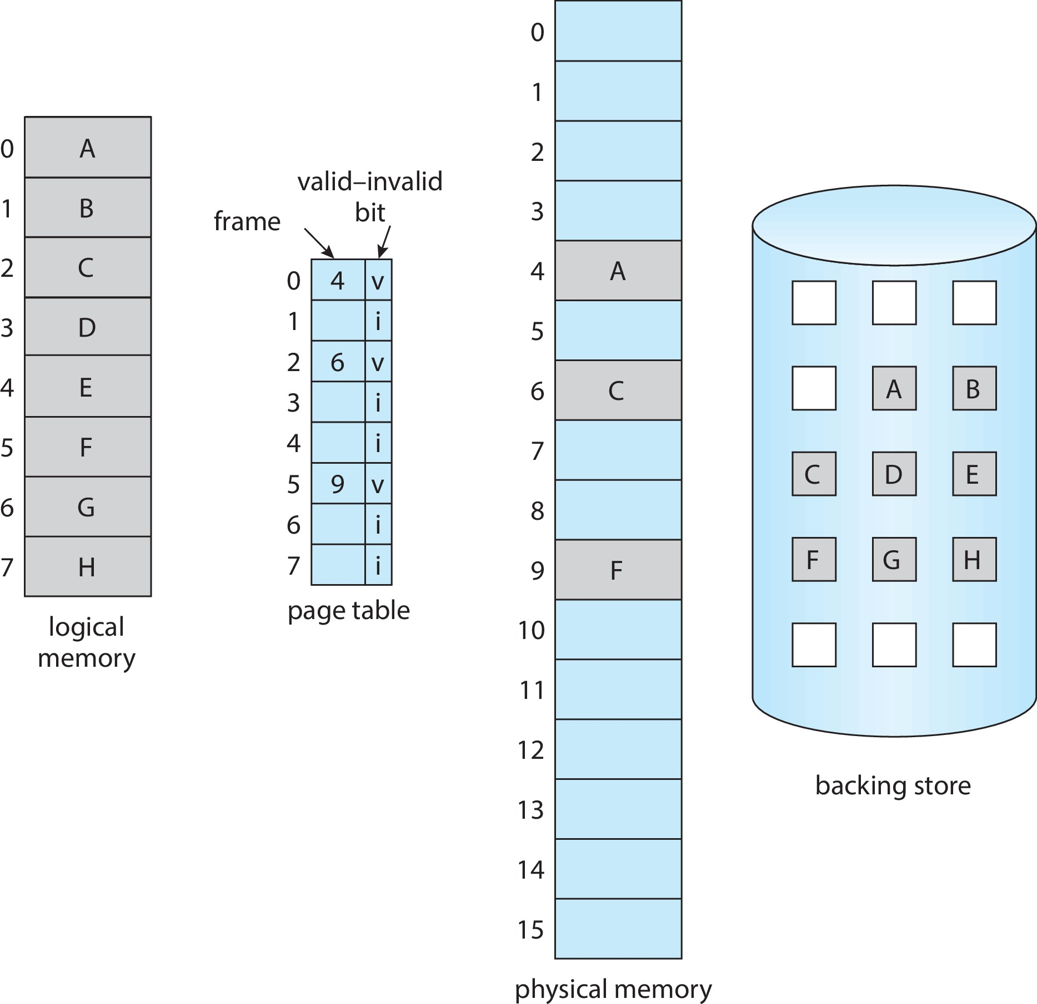
Page Table When Some Pages Are Not in Main Memory

Slide 24
Steps in Handling Page Fault
If there is a reference to a page, first reference to that page will trap(陷阱，陷入) to operating system
Page fault(页故障)
Operating system looks at another table(另一个表，非页表，比如Linux的VMA数据结构) to decide:
Invalid reference(非法引用) ⇒ abort
Just not in memory
Find free frame
Swap page into frame via scheduled disk operation
Reset tables to indicate page now in memory Set validation bit = v
Restart the instruction that caused the page fault
Notes:
Page fault trap

Slide 25
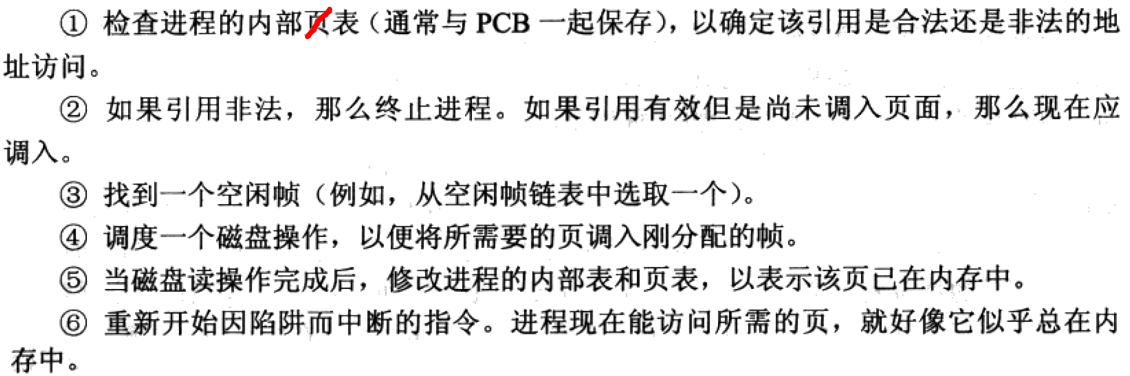
OSC7 翻译版 P274

Slide 26
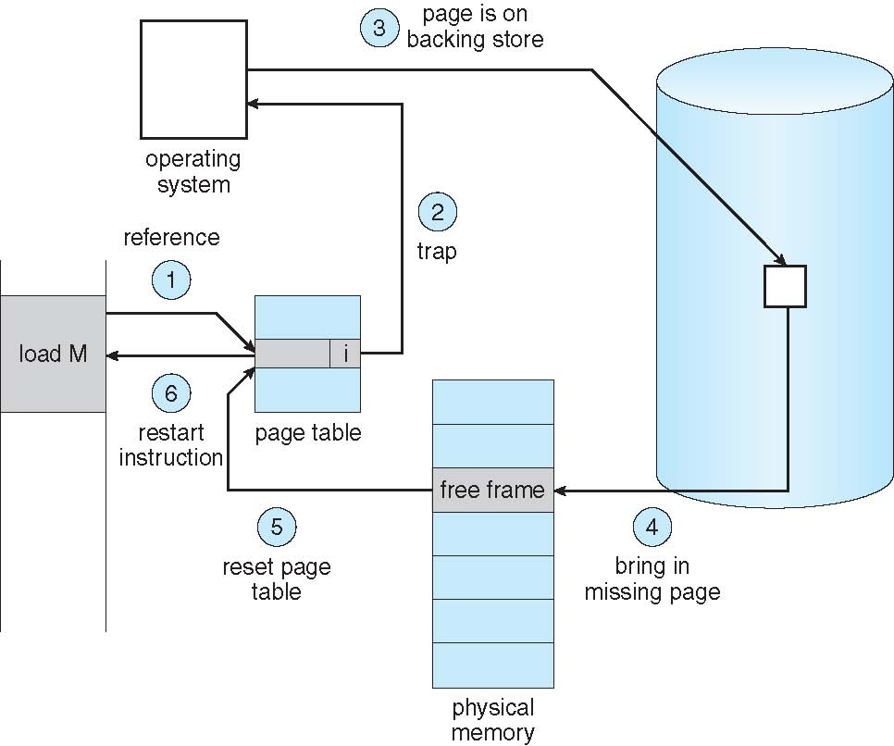
Steps in Handling a Page Fault (Cont.)

Slide 27
Aspects of Demand Paging
Extreme case – start process with no pages in memory(一种极端情况是所有的页都不在内存)
OS sets instruction pointer to first instruction of process, non-memory-resident -> page fault
And for every other process pages on first access
Pure demand paging(纯粹按需调页)
Actually, a given instruction could access multiple pages -> multiple page faults(一条指令，可能引发多个页故障)
Consider fetch and decode of instruction which adds 2 numbers from memory and stores result back to memory
Pain decreased because of locality of reference(局部引用)

Slide 28
Aspects of Demand Paging
Hardware support needed for demand paging
Page table with valid / invalid bit(页表项带有有效/无效位)
Secondary memory (swap device with swap space) 带有交换空间的次级存储器
Instruction restart
为了提高页置换性能而增设的其他硬件支持(详见9.4节)

Slide 29
Page Fault
缺页中断与一般的中断相比，有明显的不同
在指令执行期间产生和处理中断信号；一般情况下，CPU在执行完一条指令之后检查和处理中断，而缺页中断却是在指令执行期间，发现要访问的指令或数据不在内存时产生和处理的；
一条指令执行期间，可能产生多次缺页中断。
Example: IBM 370 – 6 pages to handle SS MOVE
instruction:
instruction is 6 bytes, might span 2 pages
2 pages to handle from
2 pages to handle to
SS MOVE 指令可能要产生6次缺页中断

Slide 30
Instruction Restart
Low addr
A
有时重启被中断的指令并不可行
例如：相互重叠的区域中进行块移动指令(单条指令实现块移动)
该指令将虚框内的数据移动到Page n中，由于虚框跨越两个页面，若指令开始执行时第n+1页不在内存，当将虚框内第n+1页中的数据移动到第n页时，产生缺页中断
当将第n+1页装入到主存后，虚框中第n页的内容已被修改，重启指令重新进行传送，将导致错误；（复制的是已经修改过的数据）
B
C
D
High addr
Notes:
从C点拷贝到B点时，已经改变了与目地址重叠的源数据区的部分内容(B)。当试图从D点读取时发生页故障，调入n+1页后，重启指令时，源数据区部分内容已被改变

Slide 31
Instruction Restart
对前页问题的两种解决方法
1. 块移动前，指令微码试着访问两块内存的两端，将页故障提前引发，从而保证块移动过程中不会引发页故障，也就避免了块移动过程中指令重启
2. 使用临时寄存器来保存被覆盖位置的值

Slide 32
Free-Frame List(空闲帧列表)
When a page fault occurs, the operating system must bring the desired page from secondary storage into main memory.
Most operating systems maintain a free-frame list -- a pool of free frames for satisfying such requests.
Operating system typically allocate free frames using a technique known as zero-fill-on-demand(按需填零) -- the content of the frames zeroed-out before being allocated.
When a system starts up, all available memory is placed on the free-frame list.

Slide 33
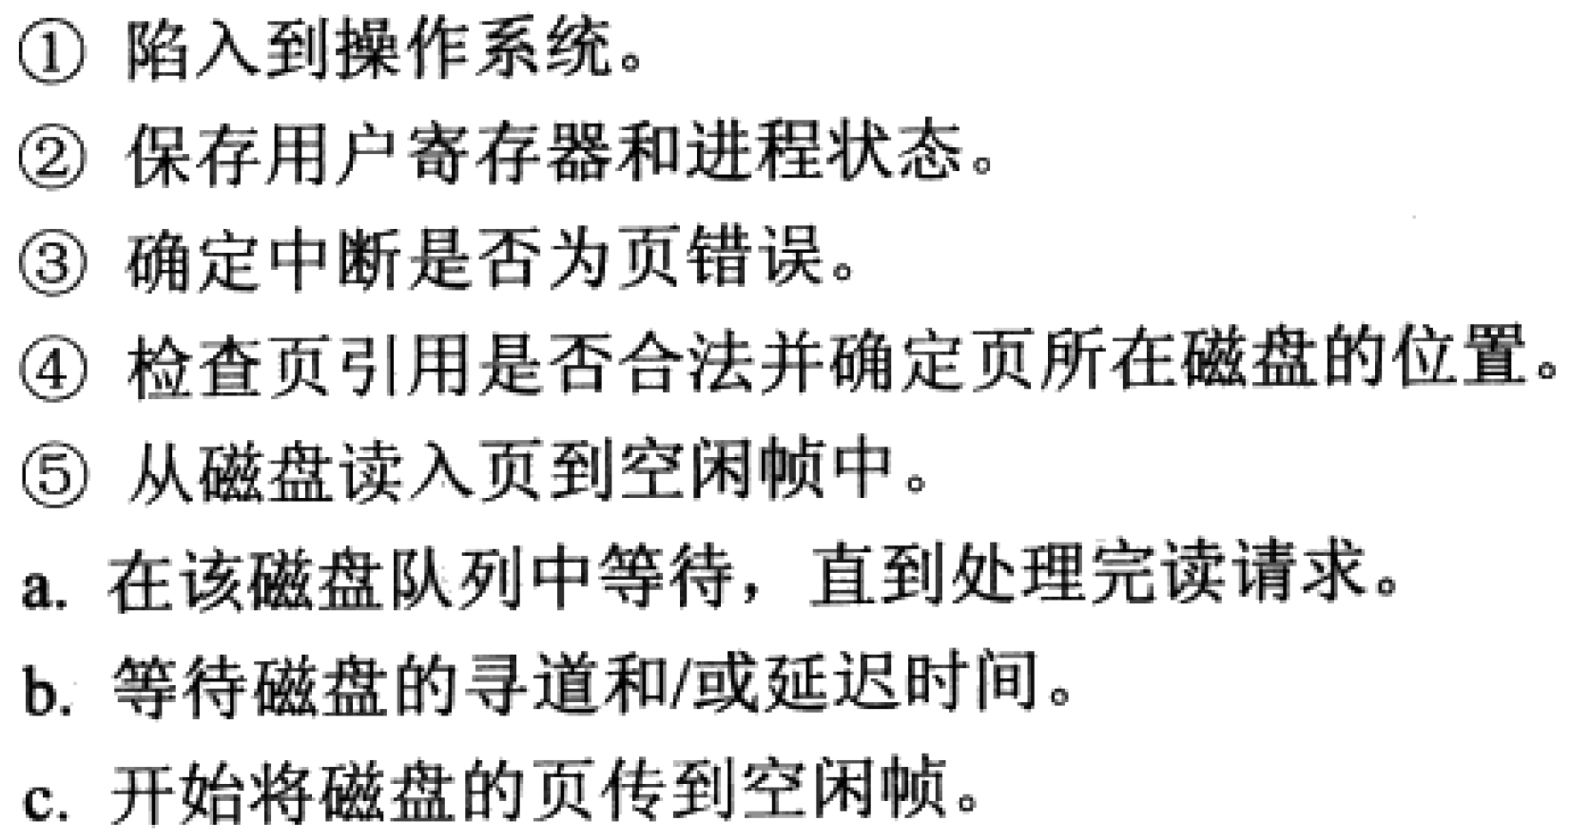
按需调页动作序列 1/2
请求

Slide 34
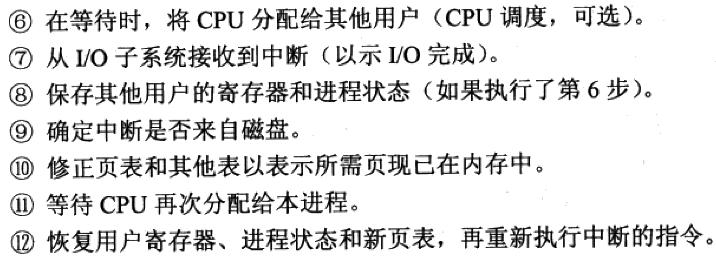
按需调页动作序列 2/2

Slide 35
Stages in Demand Paging
Trap to the operating system
Save the user registers and process state
Determine that the interrupt was a page fault
Check that the page reference was legal and determine the location of the page on the disk
Issue a read from the disk to a free frame:
Wait in a queue for this device until the read request is serviced
Wait for the device seek and/or latency time
Begin the transfer of the page to a free frame

Slide 36
Stages in Demand Paging (Cont.)
While waiting, allocate the CPU to some other user
Receive an interrupt from the disk I/O subsystem (I/O completed)
Save the registers and process state for the other user
Determine that the interrupt was from the disk
Correct the page table and other tables to show page is now in memory
Wait for the CPU to be allocated to this process again
Restore the user registers, process state, and new page table, and then resume the interrupted instruction

Slide 37
Performance of Demand Paging
按需调页的性能
Three major activities
Service the interrupt(处理中断) – careful coding means just several hundred instructions needed
Read the page(读入页) – lots of time
Restart the process(重启进程) – again just a small amount of time
Page Fault Rate 0 ≤ p ≤ 1
if p = 0 no page faults
if p = 1, every reference is a fault
Effective Access Time (EAT，有效访问时间)
EAT = (1 – p) x memory access
+ p x (page fault overhead + swap page out + swap page in )

Slide 38
Demand Paging Example
Memory access time = 200 nanoseconds
Average page-fault service time = 8 milliseconds
EAT = (1 – p) x 200 + p (8 milliseconds)
= (1 – p) x 200 + p x 8,000,000
= 200 + p x 7,999,800 ns
If one access out of 1,000 causes a page fault, then
EAT = 8.2 microseconds.
This is a slowdown by a factor of 40!!
If want performance degradation < 10 percent
200 + 7,999,800 x p < 220 7,999,800 x p < 20
p < 0.0000025
< one page fault in every 400,000 memory accesses

Slide 39
Demand Paging Optimizations
Swap space(交换空间，指交换分区) I/O faster than file system I/O even if on the same device
Swap allocated in larger chunks, less management needed than file system
Copy entire process image to swap space at process load time
Then page in and out of swap space
Used in older BSD Unix

Slide 40
Demand Paging Optimizations
Demand page in from program binary on disk, but discard rather than paging out when freeing frame(对二进制文件中的页，可从文件直接调入，调出时无需写到外存)
Used in Solaris and current BSD
Still need to write to swap space
Pages not associated with a file (like stack and heap) – anonymous memory (栈和堆仍需写入交换空间)
Pages modified in memory but not yet written back to the file system(已修改但未来得及写入文件的页)
Notes:
Mobile systems:
Typically don’t support swapping
Instead, demand page from file system and reclaim read-only pages (such as code)

Slide 41
Process Creation
Virtual memory allows other benefits during process creation:
Copy-on-Write
Memory-Mapped Files (later)

Slide 42
9.3 Copy-on-Write(写时复制)
Copy-on-Write (COW) allows both parent and child processes to initially share the same pages in memory
If either process modifies a shared page, only then is the page copied
COW allows more efficient process creation as only modified pages are copied
In general, free pages are allocated from a pool of zero-fill-on-demand pages
Pool should always have free frames for fast demand page execution
Don’t want to have to free a frame as well as other processing on page fault
Why zero-out a page before allocating it? 安全考虑

Slide 43
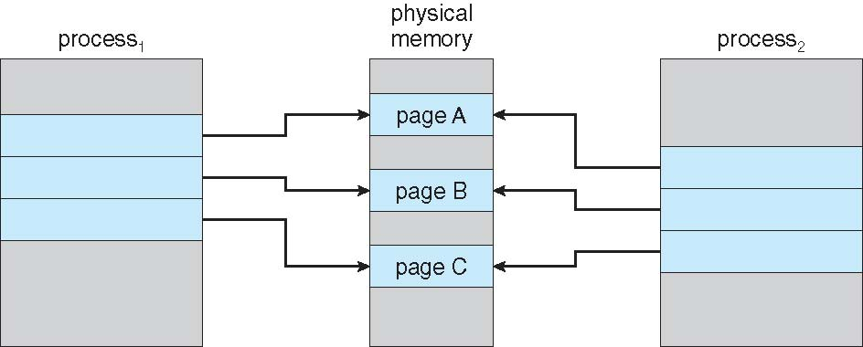
Before Process 1 Modifies Page C

Slide 44
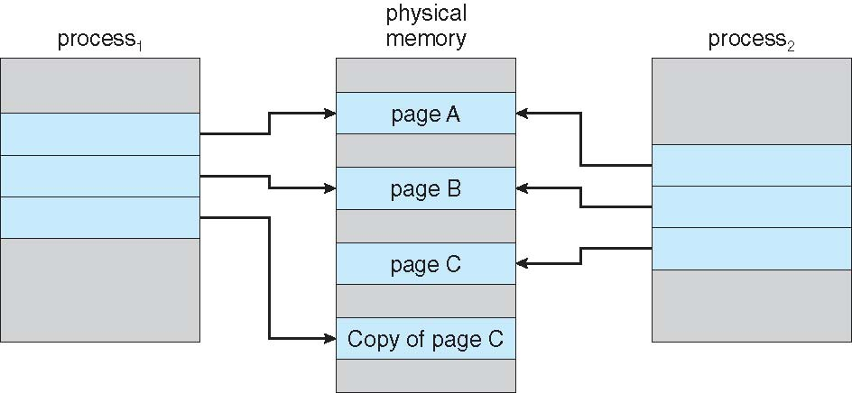
After Process 1 Modifies Page C
只有被修改了的页面才进行复制，实现父子进程地址空间的真正分离

Slide 45
vfork()
vfork() variation on fork() system call has parent suspend and child using copy-on-write address space of parent
Designed to have child call exec()
Very efficient(不使用写时复制，比写时复制还快一点，主要用于对性能要求极高的场合，或者机器没有MMU，无法实现父子进程共享地址空间的)

Slide 46
vfork()
仅用于子进程立即调exec族函数，或立即exit的情况
系统保证父进程立即被阻塞，子进程先运行
不复制父进程的页表，而是子进程直接在父进程的地址空间运行
此时子进程对任何变量的修改，都会在留存在父进程的地址空间，需小心行事。惟有exec与exit除外
通常子进程马上调用exec族函数，加载一个新的程序。此时系统为子进程创建自己的页表等数据结构，子进程就拥有了自己独立的地址空间
然后系统把父进程从阻塞中唤醒，父子进程可以并发执行

Slide 47
What Happens if There is no Free Frame?
Used up by process pages
Also in demand from the kernel, I/O buffers, etc
How much to allocate to each?
Page replacement – find some page in memory, but not really in use, page it out
Algorithm – terminate? swap out(把整个进程换出)? replace the page?
Performance – want an algorithm which will result in minimum number of page faults
Same page may be brought into memory several times

Slide 48
虚拟内存与编码质量
在一个32位(sizeof(int) == 4)请求分页存储器管理系统中，把主存分成大小相等的512字节的页；一用户定义了一个128x128的2维数组，在分页时把数组中的元素每一行放在一页中。假定分给用户可用来存放数组信息的工作区只有一页（只能存放数组中一行元素）。用户编制了如下的两个不同的程序实现数组的初始化(实际编码中应调用memset函数):
(1) int A [128, 128], i, j;
for(i = 0; i < 128; i++) // 按行访问
for(j = 0; j < 128; j++)
A[i, j] = 0;
(2) int A [128, 128], i, j;
for(j = 0; j < 128; j++) // 按列访问
for(i = 0; i < 128; i++)
A[i, j] = 0;
当分别运行上述两程序时，各会产生多少次缺页中断？(假定开始时所有页面均不在内存)
A在内存中存储的地址顺序：
A[0,0] A[0,1] ... A[0,127] A[1,0] A[1,1] ... A[1,127]
...
A[127,0] A[127,1] … A[127,127]
Notes:
(1) 128次；(2) 128 * 128 = 16384次

Slide 49
9.4 Page Replacement(页面置换)
Prevent over-allocation(过度分配) of memory by modifying page-fault service routine to include page replacement(see next ppt page)
Use modify (dirty) bit(修改位，脏位) to reduce overhead of page transfers – only modified pages are written to disk
Page replacement completes separation between logical memory and physical memory – large virtual memory can be provided on a smaller physical memory

Slide 50
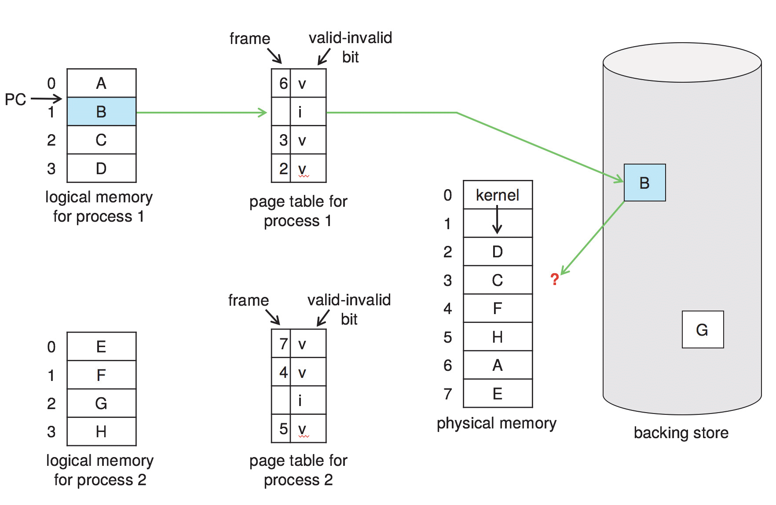
Need For Page Replacement

Slide 51
Basic Page Replacement
Find the location of the desired page on disk
Find a free frame: - If there is a free frame, use it - If there is no free frame, use a page replacement algorithm to select a victim frame(牺牲帧)
Read the desired page into the (newly) free frame. Update the page and frame tables
Restart the process

Slide 52
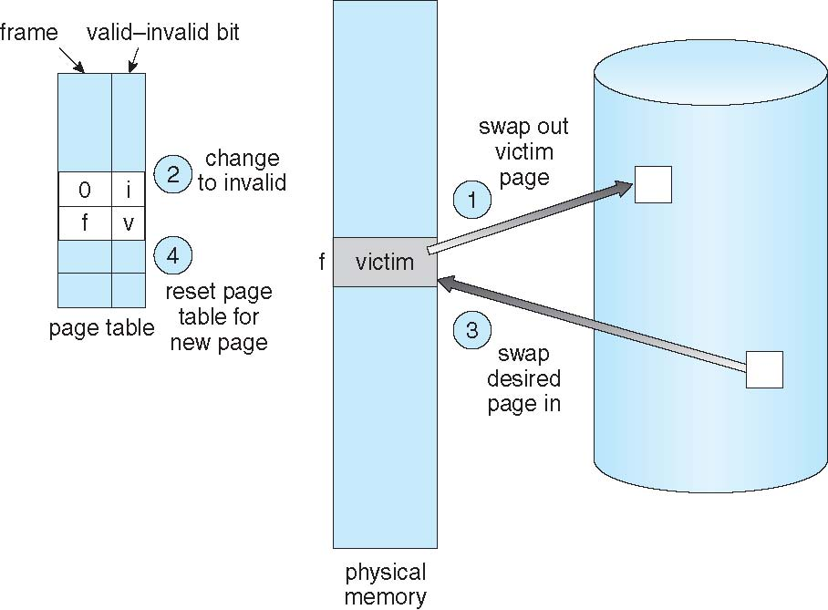
Page Replacement

Slide 53
Page and Frame Replacement Algorithms
Frame-allocation algorithm(帧分配算法) determines
How many frames to give each process
Which frames to replace
Page-replacement algorithm(页置换算法)
Want lowest page-fault rate on both first access and re-access
Evaluate algorithm by running it on a particular string of memory references (reference string) and computing the number of page faults on that string
String is just page numbers, not full addresses
Repeated access to the same page does not cause a page fault
Results depend on number of frames available
In all our examples, the reference string(引用串) of referenced page numbers is
7,0,1,2,0,3,0,4,2,3,0,3,0,3,2,1,2,0,1,7,0,1

Slide 54
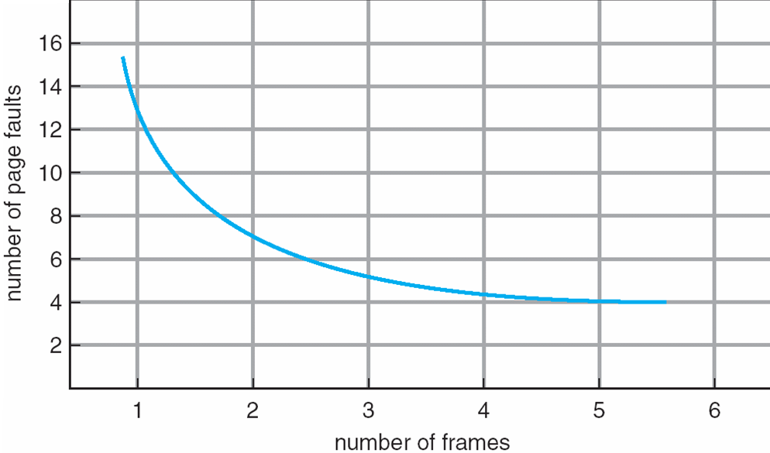
Graph of Page Faults Versus the Number of Frames

Slide 55
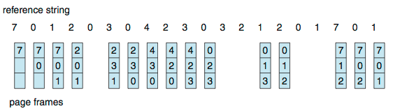
First-In-First-Out (FIFO) Algorithm
Reference string: 7,0,1,2,0,3,0,4,2,3,0,3,0,3,2,1,2,0,1,7,0,1
3 frames (3 pages can be in memory at a time per process)
Can vary by reference string: consider 1,2,3,4,1,2,5,1,2,3,4,5
Adding more frames can cause more page faults!
Belady’s Anomaly(Belady异常)
How to track ages of pages?
Just use a FIFO queue
15 page faults

Slide 56
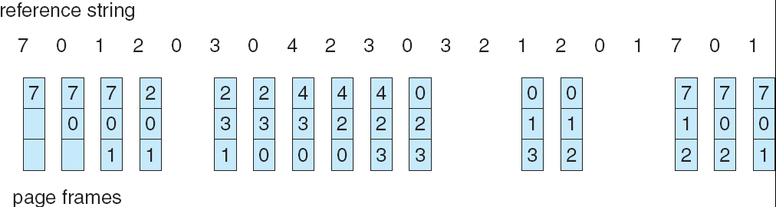
FIFO Page Replacement

Slide 57
First-In-First-Out (FIFO) Algorithm
Reference string: 1, 2, 3, 4, 1, 2, 5, 1, 2, 3, 4, 5
3 frames (3 pages can be in memory at a time per process)
4 frames
Belady’s Anomaly(异常): more frames ⇒ more page faults
1
1
4
5
2
2
1
3
9 page faults
3
3
2
4
1
1
5
4
2
2
1
5
10 page faults
3
3
2
4
4
3

Slide 58
FIFO Illustrating Belady’s Anomaly

Slide 59
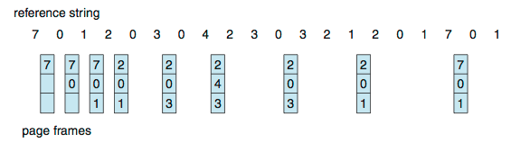
Optimal Algorithm(最优置换)
置换最远的未来才使用的页
9 is optimal for the example 具有最低的页错误率
How do you know this?
Can’t read the future 我们无法访问未来，主要用于对比其他算法的优劣
Used for measuring how well your algorithm performs
Notes:
量子力学告诉你，我们能够编辑过去......吗？ 中科院物理所 2021.5.25
https://mp.weixin.qq.com/s/xm1xNixp0Z9aMafI2U9-xQ

Slide 60
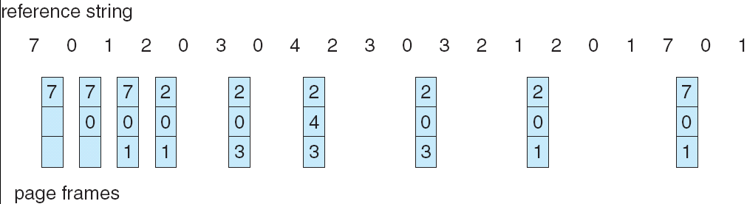
Optimal Page Replacement

Slide 61
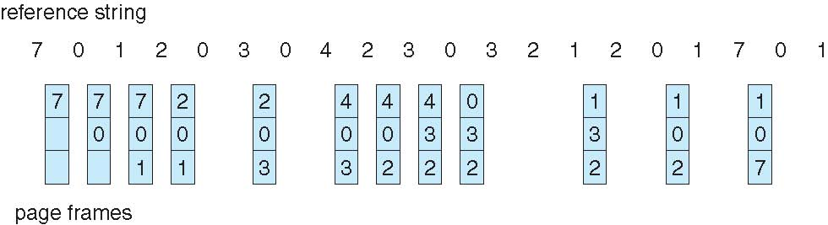
Least Recently Used (LRU) Algorithm
Use past knowledge rather than future 最近最少使用算法
Replace page that has not been used in the most amount of time
Associate time of last use with each page
12 faults – better than FIFO but worse than OPT 好于FIFO，但不及最优置换
Generally good algorithm and frequently used 效果不错
But how to implement? 但如何实现呢？
Notes:
Strangely, if we let SR be the reverse of a reference string S, then the page-fault
rate for the OPT algorithm on S is the same as the page-fault rate for the OPT
algorithm on SR.
Similarly, the page-fault rate for the LRU algorithm on S is the
same as the page-fault rate for the LRU algorithm on SR

Slide 62
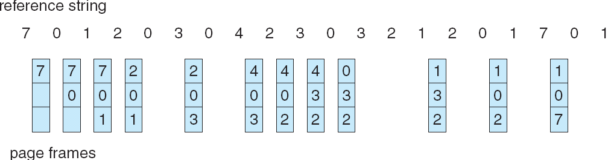
Least Recently Used (LRU) Algorithm
Reference string: 1, 2, 3, 4, 1, 2, 5, 1, 2, 3, 4, 5
1
1
1
1
5
2
2
2
2
2
3
5
5
4
4
4
4
3
3
3

Slide 63
LRU Algorithm (Cont.)
LRU性能不错，但实现可能需要一定的硬件支持，需要为页帧确定一个排序序列
两种实现：计数器，栈
Counter implementation(计数器实现)
每个页设置一个计数器，每当页被引用时，将时钟值复制进计数器
当需要换页时，查找计数值最小的，也就是最久未使用的页
需要搜索整个(时钟)表格
需要考虑时钟溢出

Slide 64
LRU Algorithm (Cont.)
Stack implementation(栈实现，但包含非标准栈操作)
Keep a stack of page numbers in a double link form:
Page referenced: 每当引用一个页时
move it to the top 将其从栈中直接移动至栈顶
The bottom one is the victim 栈底为牺牲页
requires 6 pointers to be changed 最坏情况下需修改6个指针
But each update more expensive
No search for replacement

Slide 65
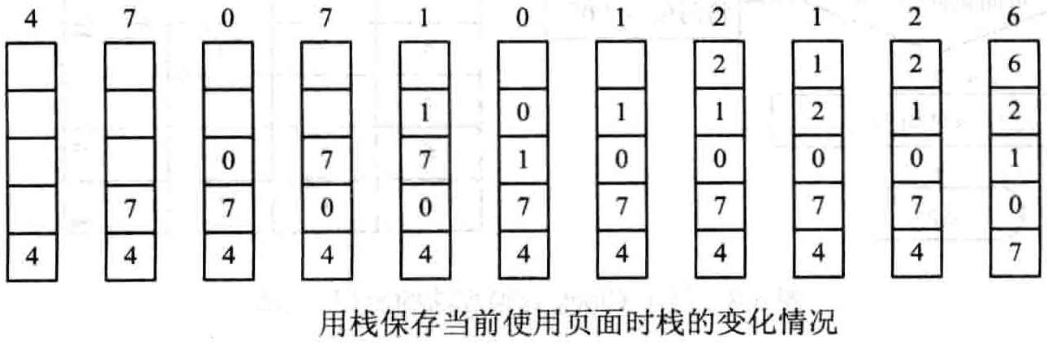
栈实现
新到的数字与栈中原有的相同数字有亲和性
牺牲页
想象：栈中的数字是有质量的，受到地球的引力影响

Slide 66
LRU Algorithm (Cont.)
LRU and OPT are cases of stack algorithms(栈算法) that don’t have Belady’s Anomaly(无Belady 异常)
Use of a stack to record most recent page references

Slide 67
LRU Approximation Algorithms
近似LRU页置换
LRU needs special hardware and still slow
Reference bit(引用位) 仅知是否引用过，但不知顺序
With each page associate a bit, initially = 0
When page is referenced bit set to 1
Replace any with reference bit = 0 (if one exists)
难以记录引用次序
Additional-Reference bit 额外的引用位
n bits reference bits, right shift n位，右移

Slide 68
Shift Registers(附加引用位算法)
在内存中每个页配一个8位的移位寄存器(非CPU内，仅仅是拿内存一个字节当移位寄存器用)：R=R₇R₆R₅ … R₂R₁R₀
一个定时器中断, 周期比如为100ms
The operating system shifting the byte(R₇R₆R₅ … R₂R₁R₀ ) right by 1 bit, discarding the low-order bit(that is 0R₇R₆ … R₃R₂R₁) ,
Shifts the reference bit for each page into the high-order bit of its 8-bit byte(R₇)，and clear the reference bit
若移位寄存器位00000000，那么该页在过去8个时间周期内都没有使用；若移位寄存器位11111111，那么该页在过去8个时间周期内都使用过
越是最近使用过的页，其移位寄存器值也就越大
对应移位寄存器最小的页，就是LRU置换页

Slide 69
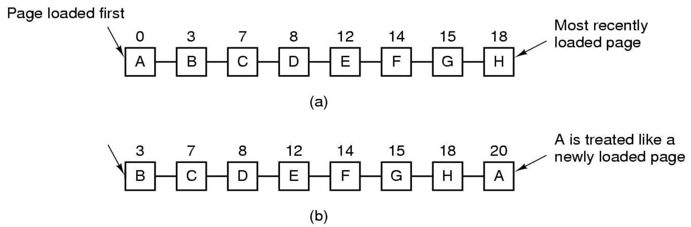
Second Chance Algorithm(二次机会算法，非时钟实现)
按照先进先出(FIFO)算法选择某一页面，检查其访问位R，如果为0，则置换该页；如果为1，则给第二次机会，将其访问位置0，并将该页移至链表尾端，彷佛该页刚刚装入一样，并继续搜索
R=1

Slide 70
Second Chance Algorithm(二次机会算法，时钟实现)
二次机会算法(非时钟实现)中，需要经常移动引用位为1的页，有点繁琐而效率不高(想象一下直线时钟，唯一的表针直线走动，且刚刚扫过的数字会自动移至直线队列末尾)
更经常用的算法是，将页面按照FIFO顺序建立一个循环队列
一个指针像时钟那样，扫描循环队列，这称为时钟算法，属二次机会算法的时钟实现
在很多场合，并不区分二次机会算法的非时钟实现，与时钟实现。但时钟实现更常见，因此更多的时候，提到二次机会算法，就指的是时钟算法

Slide 71
Second-chance(Clock) Algorithm

Slide 72
Clock Policy
页面装入时，引用位(也称为使用位U)初始化为1
当需要选择一页进行置换时，先检查其引用位
若引用位为0，淘汰该页面（因为近期该页未被访问），其帧被新页替代
若引用位为1，则不置换该页（给予该页第二次机会），将该引用位置0，然后检查下一页（按FIFO顺序）
Clock算法中，系统将置换范围内的所有frame组成一个环形缓冲区，并为其设置一个扫描指针
没有进行页面置换时，扫描指针总是指向上一次进行页面置换时被置换页面所在位置的下一个位置

Slide 73
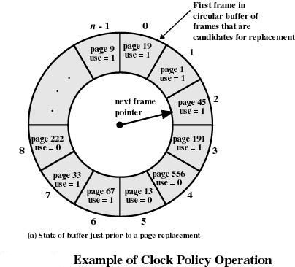
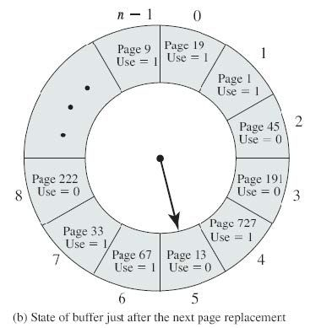

Slide 74
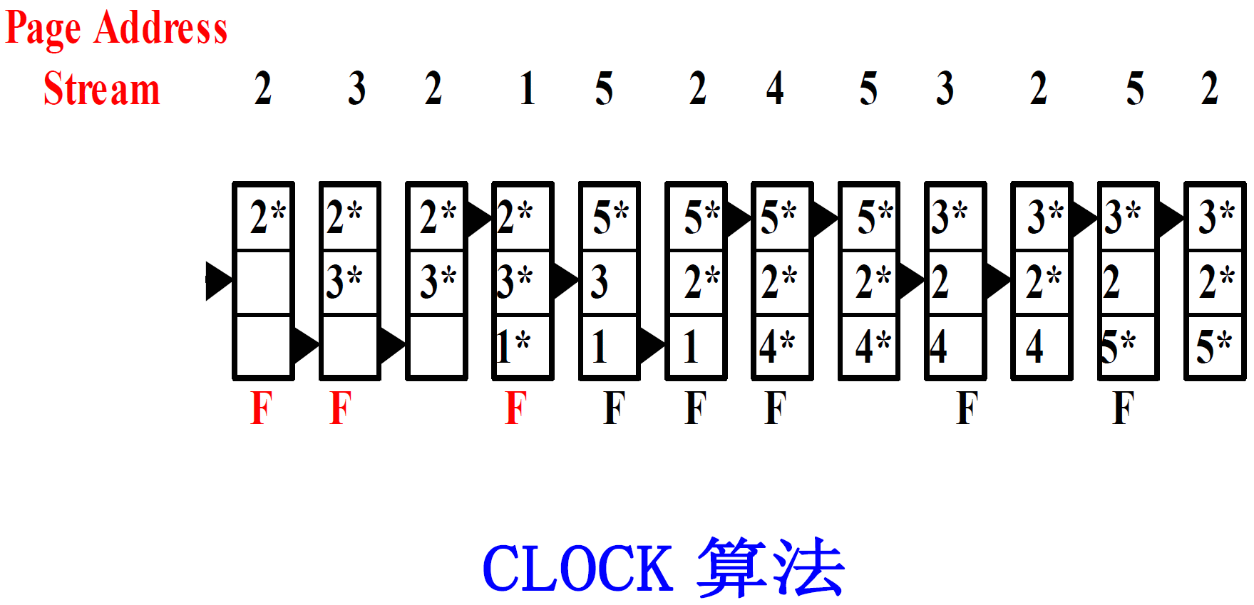
Clock Policy
* 代表使用位U为1

Slide 75
Enhanced Second-Chance Algorithm
增强型二次机会算法
Improve algorithm by using reference bit and modify bit (if available) in concert
Take ordered pair (reference, modify):
(0, 0) neither recently used not modified – best page to replace
(0, 1) not recently used but modified – not quite as good, must write out before replacement
(1, 0) recently used but clean – probably will be used again soon
(1, 1) recently used and modified – probably will be used again soon and need to write out before replacement
When page replacement called for, use the clock scheme but use the four classes replace page in lowest non-empty class
Might need to search circular queue several times

Slide 76
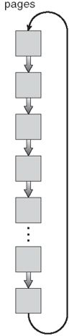
Enhanced Second Chance Algorithms
A reference bit and a modify bit
(0,0)
(0,1)
(1,0)
(1,1)
1
1
(0,0)
0
1
(0,1)
0
0
1
0
1
0
0
1
1
1

Slide 77
增强型二次机会算法
系统把一个页面移出内存时，如果该页面驻留内存期间没有被修改过，那么不必把它写回辅存，否则系统必须把它写回辅存。这表明，换出未修改过的页面比换出被修改过的页面开销小
显然，可以依据上述结论改进Clock算法。改进后的Clock算法将在置换范围内，首选在最近没有使用过、没有被修改过的页面作为被置换页面

Slide 78
增强型二次机会算法
系统为内存的每个frame配置一个Modify Bit(简称为M位）
改进后的Clock算法在选择被置换页面时将同时考虑U位和M位
一个页面的U位与M位共有四种组合：
U=0，M=0：最近没有被使用过，也没有被修改过；
U=1，M=0：最近被使用过，但没有被修改过；
U=0，M=1：最近没有被使用过，但被修改过；
U=1，M=1：最近被使用过，也被修改过

Slide 79
增强型二次机会算法
改进后的 Clock 算法按下列步骤选择被置换页面：
1、从当前位置开始搜索 U=0且 M=0 的frame。但不修改任何U位。若找到第一个U=0且M=0的frame，那么系统将该frame中的页面置换出去, 算法终止。
2、如果第一步没有成功， 那么扫描指针将回到原位。再次搜索U=0但M=1的frame。此搜索过程中，如果遇到U位为1的frame，则将其U位修改为0。若找到第一个U=0但M=1的frame，那么系统将该frame中的页面选作被置换页面, 算法终止。
3、如果第二步也没有成功(所有的U位都为1)， 那么扫描指针将再次回到原位且置换范围内的所有frame其U位均为0。此时，算法将返回第一步继续执行。
Notes:
资料：计算机操作系统(第四版) 汤小丹 梁红兵 哲凤屏 汤子瀛；
计算机操作系统 课件 -电子科技大学 蒲晓蓉 2019.zip; (网盘有)
https://www.bilibili.com/video/BV18741137LS?p=104 3 min开始，（电子科技大学）计算机操作系统 蒲晓蓉

Slide 80
Counting Algorithms(基于计数的页置换)
Keep a counter(引用计数器) of the number of references that have been made to each page
Not common
Lease Frequently Used (LFU) Algorithm(最不经常使用页置换算法):
Replaces page with smallest count
Most Frequently Used (MFU) Algorithm(最常使用页置换算法):
Based on the argument that the page with the smallest count was probably just brought in and has yet to be used

Slide 81
Lease Frequently Used (LFU) Algorithm
最不经常使用页置换算法
基于的观点：活动页应该具有最大的引用次数
所以置换计数最小的页
考虑一个页在进程开始时使用很多，但以后不再使用。按此算法，这样的页会保留在物理内存很久
解决方法：定期将计数器右移一位，指数衰减原来的计数值

Slide 82
Most Frequently Used (MFU) Algorithm
最常使用页置换算法
基于的观点：具有最小次数的页可能刚刚调进来，且还没有使用
所以置换计数最大的页
最不经常使用页置换算法(LFU)与最常使用页置换算法(MFU)都不常用。算法实现很费时，且不能很好地近似最优置换(OPT)算法

Slide 83
Page-Buffering Algorithms(页缓冲算法) 1
换页时，按普通流程，是先把牺牲帧写入外存，再把所需页面读入空出来的帧
我们可以：
系统预先保留一个空闲缓冲池，在牺牲帧写出之前，所需换入页就可读入缓冲池的一个空闲帧
然后仅需修改页表项，即可把这个原来位于缓冲池中的帧，与换入的逻辑页面联系起来，这样使得缺页的进程快速重启
而牺牲帧，可在系统相对空闲时，再真正写入磁盘。然后牺牲的帧即可进入空闲帧池

Slide 84
Page-Buffering Algorithms(页缓冲算法) 2
维护一个已修改页的列表，当调页设备空闲时，就选择一个已修改页写入磁盘，并重置其修改位
这样在选择需要换出的页时，干净(未修改)页的比例增大，减少需要换出页的数量(此时磁盘很可能并不空闲)

Slide 85
Page-Buffering Algorithms(页缓冲算法) 3
保留一个空闲帧池 ，但这些帧没有被真正征用前，是保留有原页面内容的(页缓冲算法1中上次换出的页的，而换入的页使用了缓冲池中的另一个帧)，只要记住这些帧与原虚拟页面之间的对应关系，若页面置换算法有缺陷(比如FIFO算法)，换出的页很快又换入时，若能在这些空闲帧池中查找到，就无需做真正的外存I/O了

Slide 86
Applications and Page Replacement
所有这些算法都需要OS猜测未来对页面的访问情况
有一些应用程序能比OS更好地预测自己的行为，比如数据库，能提供自己的内存管理及I/O缓冲管理
某些应用会自己分配并管理缓冲，而造成双缓冲，浪费资源
OS在内存中对该应用缓冲了一部分页面
而应用也在内存中有自己的缓冲
有的OS可以允许特殊程序绕过文件系统，直接把部分磁盘作为逻辑块数组使用
有时称为生磁盘模式(Raw disk mode)
绕过缓冲，锁，等等
但这些技术仅适合于对性能要求高的大型应用

Slide 87
9.5 Allocation of Frames(帧分配)
每一进程都需要一组最小数量的帧，由其体系架构决定。至少能够在最坏情况下，把一条汇编指令执行完(指令需要重启，帧数若不满足最小数量，在单条汇编指令上会产生多个缺页故障的循环，造成进程无法推进)
比如 IBM 370 需要6页来处理SS MOVE指令:
6个字节的指令长度，可能跨越2个页
2个页面(可能跨页)来容纳源数据
2个页面(可能跨页)来容纳目的数据
一个进程所能分配的最大帧数当然受限于系统的总空闲帧数
帧分配方案包括固定分配与优先级分配

Slide 88
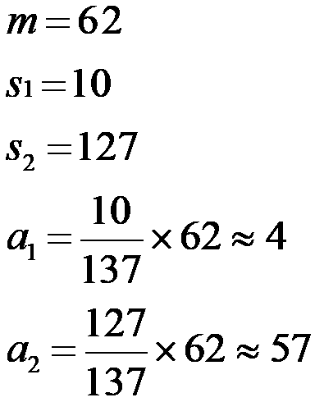
Fixed Allocation(固定分配)
Equal allocation(平均分配) –例如在满足OS后，有93个帧可用，5个进程，则每个可分18个，剩余3个用于空闲缓冲池
Proportional allocation(比例分配) –根据进程的大小，按比例分配空闲帧
随着多道程序的道数变化，已分配帧数的进程也需要动态调整帧数

Slide 89
Priority Allocation(优先级分配)
不是按照固定或进程大小的比例来分配帧数，而是按照进程的优先级来为其分配帧数
也可以综合考虑进程大小与优先级两方面的因素来为进程分配帧数

Slide 90
Global vs. Local Allocation(全局与局部分配)
Global replacement(全局置换) –系统从所有的帧集合中选择一个置换帧(可能当前属于其他进程)
可以仅允许高优先级进程从低优先级进程选择置换帧，反之则不行
单个进程不能控制其页错误率，随着运行环境的变化，周转时间可能变化很大
但系统通常有更好的吞吐量，因此更常用
Local replacement(局部置换) –每个进程仅从自己分配到的帧中选择置换帧
每个进程的性能更固定
但有可能降低内存的利用率
对防止系统颠簸有利(下面的9.6节讲述)

Slide 91
9.6 Thrashing(系统颠簸)
一个进程内存“不足”时，页故障率很高
页故障，调入页
置换已在内存的帧
但很快又被再次换回来
这将导致:
低的CPU利用率
OS误以为并发度不够(因为CPU利用率低)，于是增加程序的道数
增加新的进程进入内存
内存更加紧张，恶性循环
这种频繁调页的行为称为颠簸(Trashing)。若一个进程在换页上的时间多于执行时间，那么这个进程就在颠簸。

Slide 92
系统颠簸
对于正在运行的进程，如果分配给该进程的内存大小不足以容纳该进程的局部，则会出现页面频繁置换的现象
如： 一个循环对数组中的数据进行处理，程序包括3个页面，数据包括4个页面，共7个页面，构成一个局部；
如果分配给该局部的页框少于7个，则需要频繁进行页面置换，出现抖动；否则，在该局部执行时，不会出现抖动；
因此，分配给每个进程的页框数应不少于该进程的当前局部

Slide 93
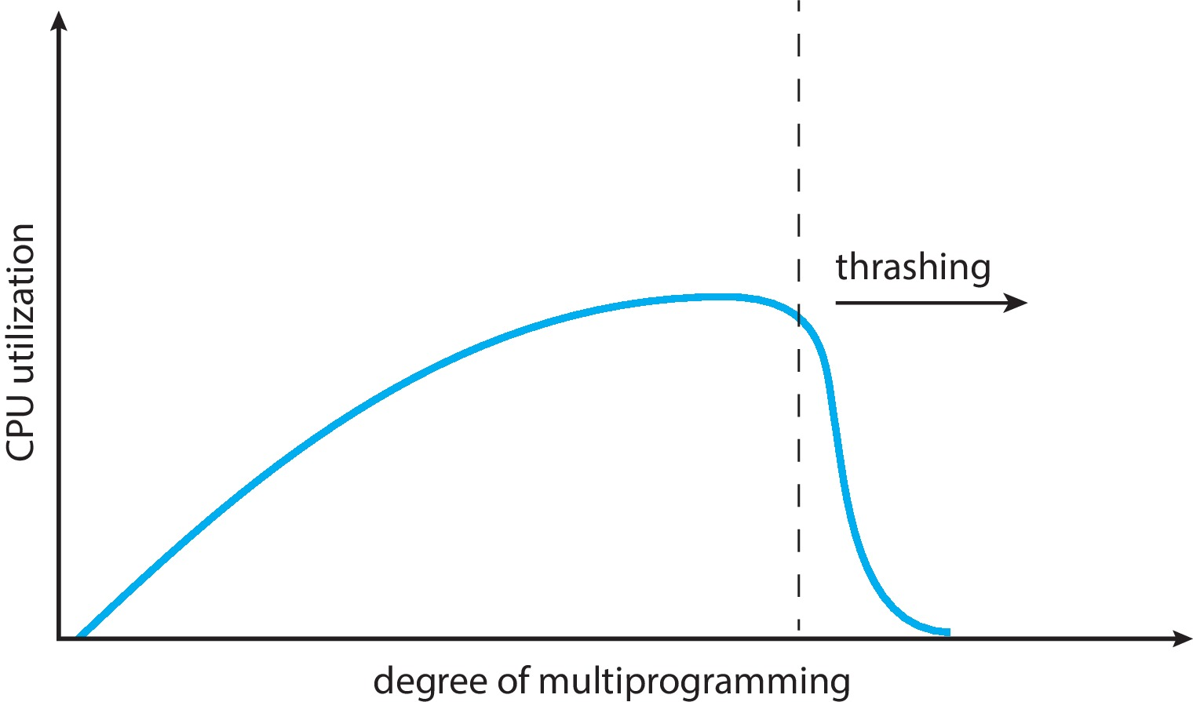
Thrashing (Cont.)
Thrashing(系统颠簸). A process is busy swapping pages in and out

Slide 94
Demand Paging and Thrashing
Why does demand paging work?
Locality model(局部性模型)
Process migrates from one locality to another
Localities may overlap
Why does thrashing occur(进程为什么会发生颠簸)?
Σ size of locality > total memory size
所有进程局部内存需求的和 > 分配的总内存
Limit effects by using local or priority page replacement(通过局部置换算法或优先置换算法能限制系统颠簸)

Slide 95
Locality in a Memory-Reference Pattern

Slide 96
Working-Set Model(工作集合模型)
Δ ≡ working-set window(工作集合窗口) ≡ 一个固定数目的页引用 比如: 10,000 个引用
WSS_{i} (进程P_{i} 的工作集合) = 在最近 Δ 内，总的引用页数(随时间变化)
若 Δ 太小，不足以包含局部
若 Δ 太大，会包含多个局部
若 Δ = ∞ ，将包含整个程序
D = Σ WSS_{i} ≡ 系统对整个帧数的需求
根据局部性计算的近似值

Slide 97
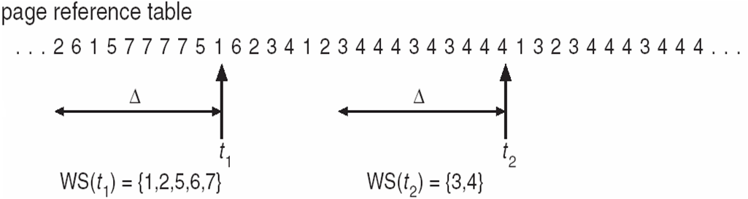
Working-Set Model (Cont.)
if D > m ⇒ Thrashing D为系统对帧数的需求，m为可用帧的数量
Policy if D > m, then suspend or swap out one of the processes

Slide 98
Keeping Track of the Working Set
难以准确跟踪工作集合
可以通过定时中断 + 引用位的方法来近似计算
例如: Δ = 10,000
定时器每 5000 个引用发生一次中断
每个页面在内存保存2位的引用位(正好Δ时长的)
当定时中断发生时，对每一页执行：1-内存中最旧的引用位被抛弃，2-拷贝页表中的引用位(0/1)进内存，3-页表中的引用位清0
只要这3个引用位有1个位为1，即可认为该页在工作集合内
这种模型并不准确，因为不知道在5000个引用的哪个位置产生的引用
改进：10 个引用位，每1000个引用发生一次中断

Slide 99
Working-Set & Page-Fault Frequency(页错误频率)
工作集合模型是成功的，但实现的开销比较大
工作集合模型可用于预先调页(见9.9.1)
但用于控制颠簸不够灵活
另一种更为直接的，控制颠簸的方法是采用页错误频率(Page-Fault Frequency)策略

Slide 100
Page-Fault Frequency(页错误频率)
颠簸必然伴随着高的页故障率
设置可接受的 page-fault frequency (PFF，页错误频率) ， 并使用局部分配策略
若页故障率太低，减少分配帧数
若页故障率太高，增加分配帧数

Slide 101
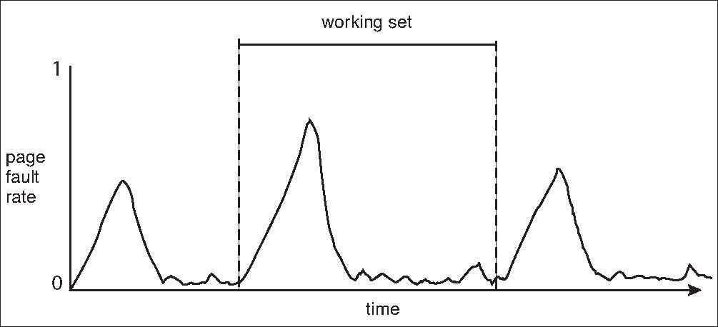
Working Sets and Page Fault Rates
进程的工作集合与其页错误率有直接关系
工作集合是时变的
页错误率波峰一般意味着正在向另一个局部迁移，波谷表示工作集合已基本就位，正处于一个相对稳定的局部内
工作集合
迁移开始
迁移结束

Slide 102
9.7 Memory-Mapped Files(内存映射文件)
文件的内存映射可将一个磁盘块映射成内存的一页(或多页)
开始的时候文件访问按普通的按需调页进行
一页大小的文件从文件系统读入物理页帧(有的系统会预读)
后续的读写操作按通常的内存访问来处理
由于是使用内存操作文件，而不是通过read()和write()系统调用，简化了文件访问
可以将同一文件映射到各自的虚拟内存中，以共享数据
何时将修改的数据写入磁盘？
周期性检查 and / or 调用close()关闭文件时
比如当调页程序在检查脏页(修改过的页)时

Slide 103
Memory Mapped Files

Slide 104
Shared Memory via Memory-Mapped I/O

Slide 105
Shared Memory in Windows API
First create a file mapping for file to be mapped
Then establish a view of the mapped file in process’s virtual address space
Consider producer / consumer
Producer create shared-memory object using memory mapping features
Open file via CreateFile(), returning a HANDLE
Create mapping via CreateFileMapping() creating a named shared-memory object
Create view via MapViewOfFile()
Sample code in Textbook

Slide 106
*Memory-Mapped I/O(内存映射I/O)
有的CPU有专用的I/O空间，其地址空间独立于内存地址空间，比如x86的I/O端口(Port)
有的CPU没有专用的I/O空间，必须分出一段连续的物理内存地址，为I/O设备用。比如设备的各种寄存器，设备内的缓冲区等。这称为内存映射I/O
即使是有专用的I/O空间的CPU，其I/O地址范围通常比较小，I/O指令也很少，功能受限。因此对显卡帧缓冲区这种存储空间，一般也会用内存映射I/O
指令对内存映射I/O的地址的访问，访问的不是内存芯片，而是映射在此地址上的I/O寄存器，或设备内的缓冲区

Slide 107
9.8 Allocating Kernel Memory(内核内存的分配)
内核内存的分配，与用户空间的内存分配不同
通常从空闲内存池(pool)中分配
内核需要大量大小不同的数据结构，有的不足一页，需特别注意碎片问题
有些内核存储区需要物理上是连续的地址
比如带DMA功能的I/O设备，这些设备在读写内存时，是不经过MMU的，因此必须直接使用物理地址
有些OS的内核代码与数据不受分页系统的控制

Slide 108
Buddy System(伙伴系统)
一种经典的内存分配方案
主要思想：将内存按2的幂进行划分，组成若干空闲块链表；查找该链表找到能满足进程需求的最佳匹配块
算法：
首先将整个可用空间看作一块： 2^{U}
假设进程申请的空间大小为 s，如果满足
2^{U-1} < s <= 2^{U}，则分配整个块
否则，将块划分为两个大小相等的伙伴，大小为2^{U-1}
一直划分下去直到产生刚刚大于或等于 s 的最小块

Slide 109
Buddy System(伙伴系统)
For example, assume 256KB chunk available, kernel requests 21KB
Split into A_{L} _{and} A_{R} of 128KB each
One further divided into B_{L} and B_{R} of 64KB
One further into C_{L} and C_{R} of 32KB each – one used to satisfy request
优点 – 可快速地合并buddy，以组成更大的空闲块。且一次释放，有可能引起连续多个层级的合并
缺点 – 内碎片通常比较大

Slide 110
Buddy System Allocator
kernel requests 21KB

Slide 111
Slab Allocator(Slab分配)
buddy系统外的另一种分配策略，在Linux中基于buddy实现
内核需要频繁申请/释放多种类别，每种类别的大小固定 (每一类大小不一)的数据结构，或者称为对象(object)，有些对象只有几十个字节长
若按为对象分配整数页的内核存储器，碎片现象很严重
基本思想是让若干个同类的objects连续存储，占据整数页的连续内核存储器，碎片现象大大减少
这些连续存放的objects及其结构，称为一个slab
因为预创建了对象，申请时可以快速从cache(非CPU内的cache，这里强调的是预先创建的，可快速分配的意思)上分配

Slide 112
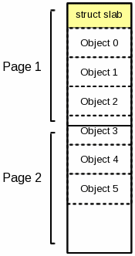
Two page slab with 6 objects
1个占据2个物理连续页面的slab，内含6个对象。
注意Object 3跨越了Page1/2的边界。

Slide 113
Slab Allocator(Slab分配)
Slab 占据一至多个物理连续页面
Cache 包含一至多个slab
每个cache中只有一种特定的内核数据结构
Each cache filled with objects – instantiations of the data structure
当创建cache时，包含的objects均被标记为free
当实际的对象存入结构时，objects被标记为used
申请一个对象时，先查部分满的slab，若无则查空的slab，仍无则分配新的slab，并分配给该对象
优点：(几乎)无碎片；快速地完成存储对象的分配请求

Slide 114
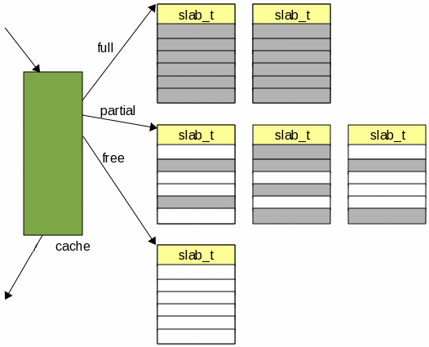
Cache, Slab & Object
来自上个cache
满的slab：slab中所有object已标记为使用
在有些资料的上下文中，把cache与slab合称为cache，注意理解区分。cache本身并不直接存储对象
部分满的slab：slab中有的object标记为使用，有的标记为空闲
空的slab：slab中所有object已标记为空闲
指向下个cache

Slide 115
*Slab Allocator in Linux
For example process descriptor is of type struct task_struct
Approx 1.7KB of memory
New task -> allocate new struct from cache
Will use existing free struct task_struct
Slab can be in three possible states
Full – all used
Empty – all free
Partial – mix of free and used
Upon request, slab allocator
Uses free struct in partial slab
If none, takes one from empty slab
If no empty slab, create new empty

Slide 116
*Slab Allocator in Linux (Cont.)
Slab started in Solaris, now wide-spread for both kernel mode and user memory in various OSes
Linux 2.2 had SLAB, now has both SLOB and SLUB allocators
SLOB for systems with limited memory
Simple List of Blocks – maintains 3 list objects for small, medium, large objects
SLUB is performance-optimized SLAB removes per-CPU queues, metadata stored in page structure

Slide 117
*9.9 Other Considerations(其他考虑)
Prepaging
Page size
TLB reach
Inverted page table
Program structure
I/O interlock and page locking

Slide 118
Prepaging
To reduce the large number of page faults that occurs at process startup
Prepage all or some of the pages a process will need, before they are referenced
But if prepaged pages are unused, I/O and memory was wasted
Assume s pages are prepaged and α of the pages is used
Is cost of s * α save pages faults > or < than the cost of prepaging s * (1- α) unnecessary pages?
α near zero ⇒ prepaging loses

Slide 119
Page Size
Sometimes OS designers have a choice
Especially if running on custom-built CPU
Page size selection must take into consideration:
Fragmentation
Page table size
Resolution
I/O overhead
Number of page faults
Locality
TLB size and effectiveness
Always power of 2, usually in the range 2¹² (4,096 bytes) to 2²² (4,194,304 bytes)
On average, growing over time

Slide 120
TLB Reach
TLB Reach - The amount of memory accessible from the TLB
TLB Reach = (TLB Size) X (Page Size)
Ideally, the working set of each process is stored in the TLB
Otherwise there is a high degree of page faults
Increase the Page Size
This may lead to an increase in fragmentation as not all applications require a large page size
Provide Multiple Page Sizes
This allows applications that require larger page sizes the opportunity to use them without an increase in fragmentation

Slide 121
Program Structure
Program structure
int[128,128] data;
Each row is stored in one page
Program 1
for (j = 0; j <128; j++) for (i = 0; i < 128; i++) data[i,j] = 0;
128 x 128 = 16,384 page faults
Program 2
for (i = 0; i < 128; i++) for (j = 0; j < 128; j++) data[i,j] = 0;
128 page faults

Slide 122
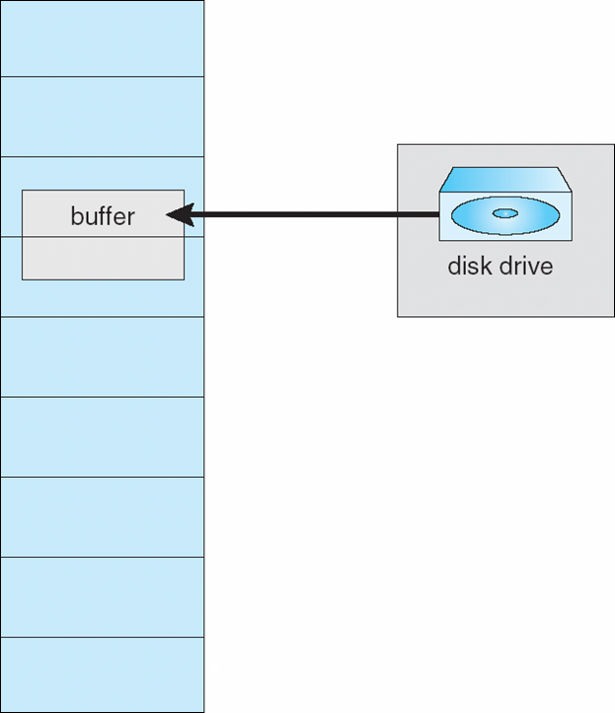
I/O Interlock
I/O Interlock – Pages must sometimes be locked into memory
Consider I/O - Pages that are used for copying a file from a device(usually with DMA) must be locked from being selected for eviction by a page replacement algorithm
Pinning of pages to lock into memory

Slide 123
*9.10 Operating System Examples
Windows
Solaris

Slide 124
Windows
Uses demand paging with clustering. Clustering brings in pages surrounding the faulting page
Processes are assigned working set minimum and working set maximum
Working set minimum is the minimum number of pages the process is guaranteed to have in memory
A process may be assigned as many pages up to its working set maximum
When the amount of free memory in the system falls below a threshold, automatic working set trimming is performed to restore the amount of free memory
Working set trimming removes pages from processes that have pages in excess of their working set minimum

Slide 125
Solaris
Maintains a list of free pages to assign faulting processes
Lotsfree – threshold parameter (amount of free memory) to begin paging
Desfree – threshold parameter to increasing paging
Minfree – threshold parameter to being swapping
Paging is performed by pageout process
Pageout scans pages using modified clock algorithm
Scanrate is the rate at which pages are scanned. This ranges from slowscan to fastscan
Pageout is called more frequently depending upon the amount of free memory available
Priority paging gives priority to process code pages

Slide 126
Solaris 2 Page Scanner

Slide 127
Summary 1/4
Virtual memory abstracts physical memory into an extremely large uniform array of storage.
The benefits of virtual memory include the following: (1) a program can be larger than physical memory, (2) a program does not need to be entirely in memory, (3) processes can share memory, and (4) processes can be created more efficiently.
Demand paging(按需调页) is a technique whereby pages are loaded only when they are demanded during program execution. Pages that are never demanded are thus never loaded into memory.
A page fault(页故障，页错误，页异常) occurs when a page that is currently not in memory is accessed. The page must be brought from the backing store into an available page frame in memory.

Slide 128
Summary 2/4
Copy-on-write(写时复制) allows a child process to share the same address space as its parent. If either the child or the parent process writes (modifies) a page, a copy of the page is made.
When available memory runs low, a page-replacement algorithm(页置换算法) selects an existing page in memory to replace with a new page. Page replacement algorithms include FIFO, optimal, and LRU. Pure LRU algorithms are impractical to implement, and most systems instead use LRU-approximation algorithms.
Global page-replacement algorithms select a page from any process in the system for replacement, while local page-replacement algorithms select a page from the faulting process.

Slide 129
Summary 3/4
Thrashing(系统颠簸) occurs when a system spends more time paging than executing.
A locality represents a set of pages that are actively used together. As a process executes, it moves from locality to locality. A working set(工作集合) is based on locality and is defined as the set of pages currently in use by a process.

Slide 130
Summary 4/4
Kernel memory is allocated differently than user-mode processes; it is allocated in contiguous chunks of varying sizes. Two common techniques for allocating kernel memory are (1) the buddy system(伙伴系统) and (2) slab allocation.
TLB reach(TLB范围) refers to the amount of memory accessible from the TLB and is equal to the number of entries in the TLB multiplied by the page size. One technique for increasing TLB reach is to increase the size of pages.
Linux, Windows, and Solaris manage virtual memory similarly, using demand paging and copy-on-write, among other features. Each system also uses a variation of LRU approximation known as the clock algorithm.

Slide 131
End of Chapter 9: Virtual Memory

